Slide 1
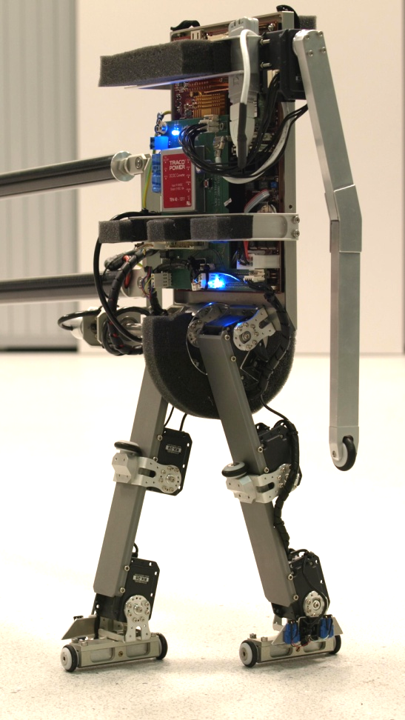
Speeding up on-line reinforcement learning using model-learning techniques
Literature colloquium
Thijs Ramakers
Supervisors: prof. dr. R. Babuška
dr. G. Lopes
E. Schuitema, M.Sc
July 4, 2009
<number> of 18
Delft Center for Systems and Control
Notes:
Hello everybody, thanks for being present here.
Last three months I have worked on my literature survey, titled “Speeding up on-line reinforcement learning using model-learning techniques”, and today I want to tell you what this is about.

Slide 2
Overview
Why learning?
Reinforcement learning
Build a model to speed up learning
Learning a model
Problems with model-learning
Conclusions and Future work
July 4, 2009
<number> of 18
Notes:
Introduction
- Short introduction about what this presentation will be about.
RL
- Short introduction to the RL and its solution methods. The most important aspects and terms of RL will be mentioned
VF approximation
- Methods of approximation / generalization for continuous variables.
Model building
- Methods for building a model of the environment.
Increasing learning speed
- Methods for increasing the speed of learning
conclusions

Slide 3
Why learning?
Many applications:
    Complex problems
    Autonomous robots
    Learn from experiences
    Adapt to changes
    Learn from mistakes
Final application:
    Two-legged humanoid robot ‘Leo’
July 4, 2009
<number> of 18
Notes:
Learning can be used in several cases:
Complex problems that are difficult to analyze
Autonomous robots that should learn without a supervisor
Systems in a changing environment could use learning to adapt.
The final application will be Leo. It’s learning task could be for example learning to stand up, walk or kick a ball.

Slide 4
Overview
Why learning?
Reinforcement learning
Build a model to speed up learning
Learning a model
Problems with model-learning
Conclusions and Future work
July 4, 2009
<number> of 18
Notes:
I will continue with a short introduction to the RL framework. Introduce commonly used terms and solution methods

Slide 5
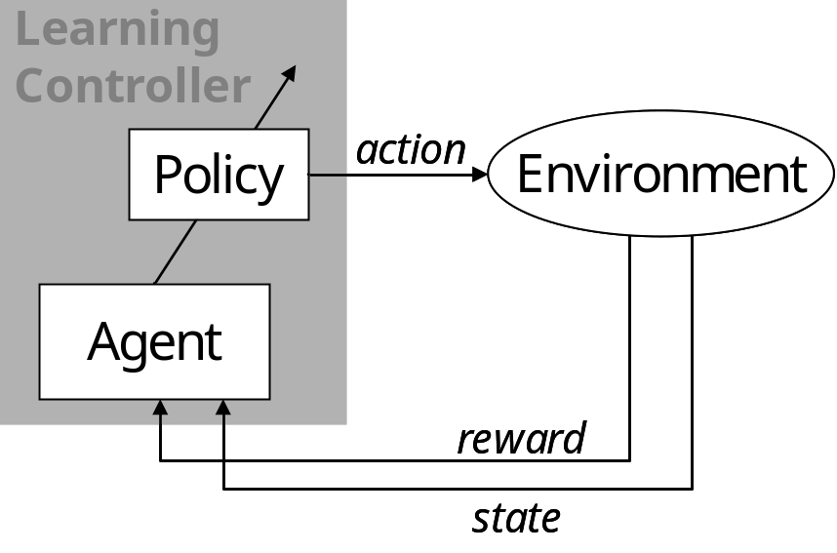
Reinforcement Learning (1/4)
At each time step
Process is in a state
Controller takes action according to its policy
Process makes transition into next state
Controller receives reward
July 4, 2009
<number> of 18
Notes:
RL is derived from the idea that past experiences can be used for future behavior. RL is trial and error.
System is in a state that fully describes the system. An action is tried, a scalar reward is the received feedback. Agent’s goal: maximize the reward that is received during an episode. The action in every state is the policy. This process is called a Markov Decision Process.
State
Action
Policy
State transition function (probabilistic / deterministic)
Reward function

Slide 6
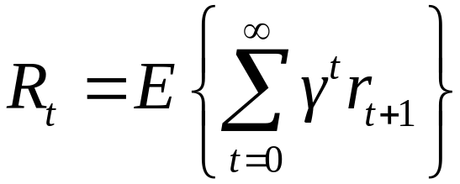
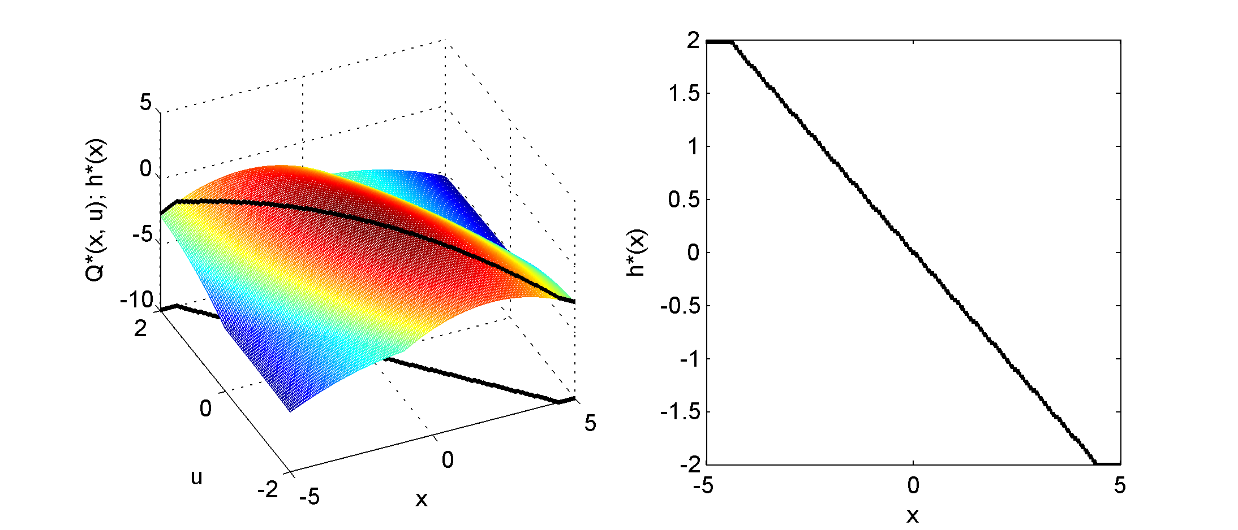
Reinforcement Learning (2/4)
Learning goal:
Find a policy that maximizes return
Value function represents
expected return of states
July 4, 2009
<number> of 18
Notes:
The goal for a RL controller is to maximize the expected (discounted) return.
Every state(-action) can be given a value. This value is the expected total reward under a certain policy. The optimal policy maximizes this return.

Slide 7
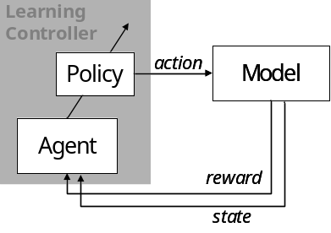
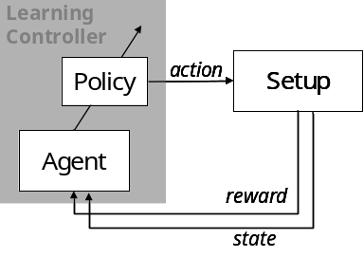
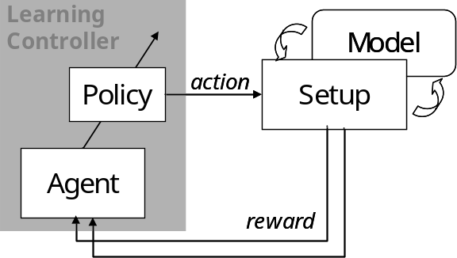
Reinforcement Learning (3/4)
Three solution approaches:
  Model-based
  Dynamic Programming
  [Bellman, 1957]
  Model-free
  Temporal Difference
  - Q-learning [Watkins, 1989]
  - SARSA [Rummery & Niranjan, 1994]
  Model-learning
  Dyna [Sutton, 1990]
  Prioritized Sweeping [Moore & Atkeson, 1993]
July 4, 2009
<number> of 18
Notes:
We separate three different classes of solution methods
Model-based:
full environment model is available (all transition probabilities and rewards function).
Solution method: Dynamic Programming. Iterative method
Model-free:
No a priori model of the environment is available.
No model is learned, only a value function is stored.
Solution methods: Monte Carlo (based on experience divided into episodes), Temporal Difference (learning on every time step)
Model-learning:
No a priori model is available, but model is learned during the learning process.
Solution method: Switching between on-line (model-free) and off-line (model-based) learning.
This is the method we will focus on. Particularly the model-based part.

Slide 8
Reinforcement Learning (4/4)
Solving problems is slow due to:
    High number of states
    High number of dimensions
    Slow propagation of information
July 4, 2009
<number> of 18
Notes:
We separate three different classes of solution methods
Model-based:
full environment model is available (all transition probabilities and rewards function).
Solution method: Dynamic Programming. Iterative method
Model-free:
No a priori model of the environment is available.
No model is learned, only a value function is stored.
Solution methods: Monte Carlo (based on experience divided into episodes), Temporal Difference (learning on every time step)
Model-learning:
No a priori model is available, but model is learned during the learning process.
Solution method: Switching between on-line (model-free) and off-line (model-based) learning.
This is the method we will focus on. Particularly the model-based part.

Slide 9
Build a model to speed up learning
Experiences are used more than once
Update larger part of state-space
Use complete sample interval
July 4, 2009
<number> of 18
Notes:
We separate three different classes of solution methods
Model-based:
full environment model is available (all transition probabilities and rewards function).
Solution method: Dynamic Programming. Iterative method
Model-free:
No a priori model of the environment is available.
No model is learned, only a value function is stored.
Solution methods: Monte Carlo (based on experience divided into episodes), Temporal Difference (learning on every time step)
Model-learning:
No a priori model is available, but model is learned during the learning process.
Solution method: Switching between on-line (model-free) and off-line (model-based) learning.
This is the method we will focus on. Particularly the model-based part.

Slide 10
Overview
Why learning?
Reinforcement learning
Build a model to speed up learning
Learning a model
Problems with model-learning
Conclusions and Future work
July 4, 2009
<number> of 18
Notes:
The RL methods presented work very well in small, discrete state-spaces. In larger or continuous spaces we can no longer list all the states and/or actions. Therefore we need to approximate the value function.

Slide 11
Building a model (1/4)
Tabular approach
[Bakker, 2006], [Sutton, 1996]
Store experiences:
  (s_{t}, a_{t}) → (s_{t+1}, r_{t+1})
Aggregate states (generalization)
Estimate probability
Past Experiences:
(s₁, a₁) → (s₂, r₁)
(s₂, a₄) → (s₃, r₂)
(s₁, a₁) → (s₄, r₃)
(s₄, a₂) → (s₁, r₁)
(s₅, a₃) → (s₁, r₃)
....
(s₁, a₂) → (s₃, r₂)
July 4, 2009
<number> of 18
Notes:
When using a model-learning method, the model has to be approximated during the learning process. The model consists of the full transition function and the reward function.
The tabular approach is the most straightforward. Past experiences are stored and used as a ‘model’. The frequency of a transition determines the probability.
This approach means storing all experiences and is thus very memory-intensive. It needs discrete states and actions, so discretization is needed.
However, this approach is used supprisingly often in the literature.

Slide 12
Building a model (2/4)
        K-Nearest Neighbor
        Memory based
        Search nearest samples
        Take average output
X₂
X
X₁
July 4, 2009
<number> of 18
Notes:
The K-Nearest Neighbor method also relies on storing past input-output pairs.
The estimated output is simply obtained by averaging the output of the K nearest stored inputs. Calculating the distances of all samples is the most computationally heavy.
K can be seen as a measure for the amount of generelization.
Local Linear Regression can be seen as an extension to KNN. Instead of averaging the outputs, a linear model is fitted to the K data samples. This leads to a piece-wise linear model.
A simple Least Squares approach can be used. Weighted Least Squares is also possible to give a higher weight to close samples.

Slide 13
Building a model (3/4)
        Local Linear Regression
[Vaandrager, 2008]
        Search nearest samples
        Estimate linear model
        Extend with weights
y
y_{q}
X_{q}
X
July 4, 2009
<number> of 18
Notes:
The K-Nearest Neighbor method also relies on storing past input-output pairs.
The estimated output is simply obtained by averaging the output of the K nearest stored inputs. Calculating the distances of all samples is the most computationally heavy.
K can be seen as a measure for the amount of generelization.
Local Linear Regression can be seen as an extension to KNN. Instead of averaging the outputs, a linear model is fitted to the K data samples. This leads to a piece-wise linear model.
A simple Least Squares approach can be used. Weighted Least Squares is also possible to give a higher weight to close samples.

Slide 14
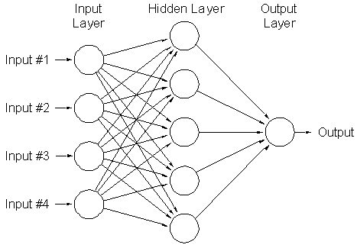
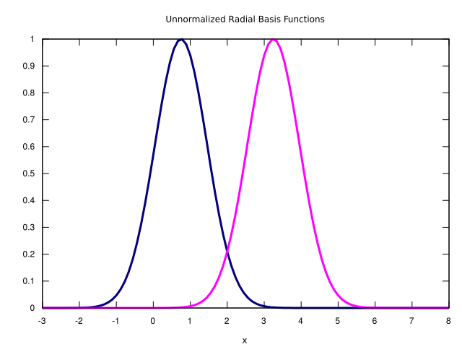
Building a model (4/4)
        Radial Basis Function Network
        Neural Network
        [Tesauro, 1995]
July 4, 2009
<number> of 18
Notes:
The K-Nearest Neighbor method also relies on storing past input-output pairs.
The estimated output is simply obtained by averaging the output of the K nearest stored inputs. Calculating the distances of all samples is the most computationally heavy.
K can be seen as a measure for the amount of generelization.
Local Linear Regression can be seen as an extension to KNN. Instead of averaging the outputs, a linear model is fitted to the K data samples. This leads to a piece-wise linear model.
A simple Least Squares approach can be used. Weighted Least Squares is also possible to give a higher weight to close samples.

Slide 15
Problems with model-learning
  Obtain representative state-transitions
  Probabilistic state-transitions
Dealing with continuous variables
Generalization versus resolution
July 4, 2009
<number> of 18
Notes:
The model-building techniques relie on stored input-output pairs.
Storing all experiences is impossible, especially after many experiences. A decision has to be made in which experiences should be stored and which can be ignored.
Generelization ←→ Approximation

Slide 16
Overview
Why learning?
Reinforcement learning
Build a model to speed up learning
Learning a model
Problems with model-learning
Conclusions and Future work
July 4, 2009
<number> of 18
Notes:
Some more techniques exist that can speed up learning.

Slide 17
Conclusions
Model-learning methods can speed up learning
Problem: Building a representative model
Application of model-learning techniques on robot Leo
Future work
July 4, 2009
<number> of 18
Notes:
Exploration is needed to guide the agent to unexplored parts of the state-space. Directed exploration makes sure that explorative action are in a possible interesting part of the state-space.
Prioritized Sweeping (Queue-Dyna) is a method to speed up the model-based part of Dyna.
Instead of randomly updating states, a priority queue is maintained to update interesting states first. This directs computational effort to interesting parts of the state-space. It prevents that a lot of computing time is wasted on states that are not interesting.

Slide 18
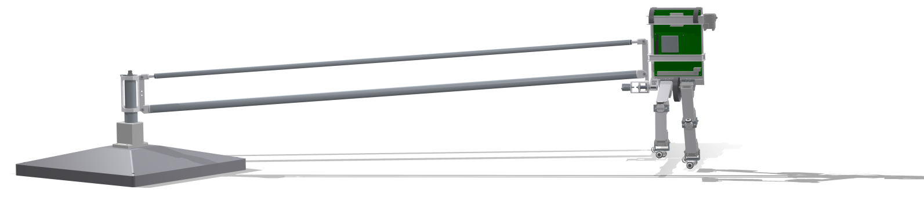
Questions, Comments, Suggestions?
July 4, 2009
<number> of 18
Notes:
Are there any questions? Or suggestions?

